Slide 1

Cache Memory
Define Cache
Understand how cache works
Write cache-friendly code
① Cache Concepts
② Cache Organization
③ Writing Cache-friendly Code
Notes:
Minh-Quoc NGHIEM
Last update: 07/12/2016

Slide 2





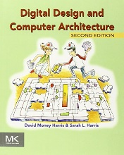
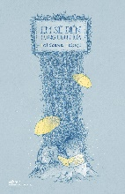


Cache Concepts
Memory
CPU
Cache

Slide 3
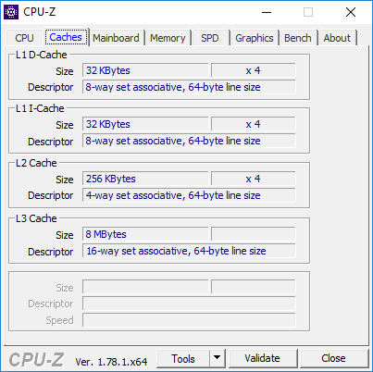
Notes:
32 KBytes, 8-way set associative, 64-byte line size

Slide 4
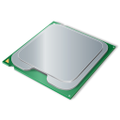
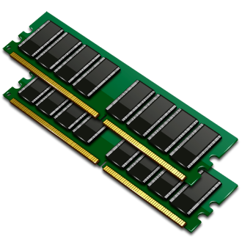


Regs
Smaller,
Faster,
costlier
L1 cache
(SRAM)
L2 cache
(SRAM)
Larger,
slower,
cheaper
L3 cache
(SRAM)
Main memory
(DRAM)
Local secondary storage
(local disks)
Remote secondary storage
(distributed file systems, Web servers)
Notes:
Cache: A smaller, faster storage device that acts as a staging area for a subset of the data in a larger, slower device.
Fundamental idea of a memory hierarchy:
For each k, the faster, smaller device at level k serves as a cache for the larger, slower device at level k+1.
Why do memory hierarchies work?
Because of locality, programs tend to access the data at level k more often than they access the data at level k+1.
Thus, the storage at level k+1 can be slower, and thus larger and cheaper per bit.
Big Idea: The memory hierarchy creates a large pool of storage that costs as much as the cheap storage near the bottom, but that serves data to programs at the rate of the fast storage near the top.

Slide 5
Cache organization
1 valid bit
t tag bits
B = 2^{b} bytes
v
Tag
0
1
• • •
B–1
E lines
per set
Set 0
• • •
• • •
• • •
Set 1
• • •
S = 2^{s}
sets
• • •
• • •
Set S-1
• • •
• • •
Notes:
…

Slide 6
Partition of Address
t bits
s bits
b bits
Tag
Set index
Block offset

Slide 7
Memory address has 32 bits, determine S, t, s, b?
C | B | E | S | t | s | b
1,024 | 4 | 1
1,024 | 8 | 4
1,024 | 32 | 32
32KB | 64 | 8
246KB | 64 | 4
8MB | 64 | 16
Notes:
Memory address 32 bits

Slide 8
32 KBytes
8-way set associative
64-byte line size
20 tag bits
64 bytes
v
Tag
0
1
• • •
63
8 lines
per set
Set 0
• • •
• • •
• • •
Set 1
• • •
64
sets
• • •
• • •
• • •
Set 63
• • •
• • •
Notes:
64 sets

Slide 9
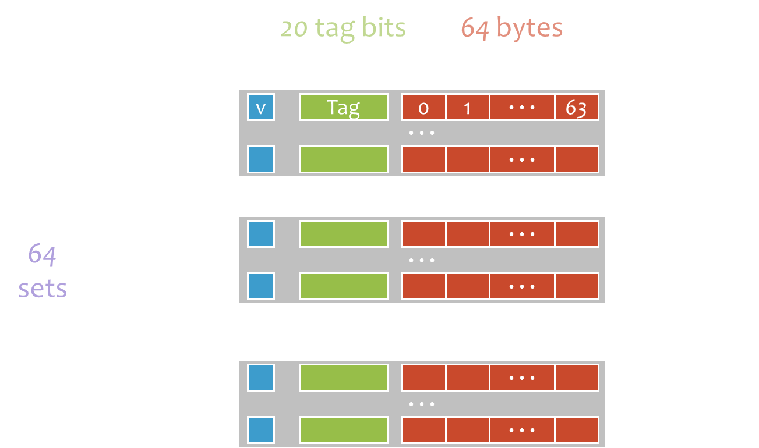
…
0x0
0x198
0x11
0x190
0x22
0x188
0x33
0x180
0x44
0x178
0x55
0x170
0x66
0x168
0x77
0x160
0x88
0x158
0x99
0x150
0xAA
0x148
1
00 … 00
…
0xBB
0x140
0xBB
0xAA
0x99
0x44
0xCC
0x138
0
8
16
63
0xDD
0x130
0xEE
0x128
0xFF
0x120
Set 5
Offset 16
0x12
0x118
0x34
0x110
‭00 … 00 0001 01 01 0000‬
0x56
0x108
0x78
0x100
…
Notes:
Có thể phải chia nhỏ ra để bỏ 1 byte vào

Slide 10
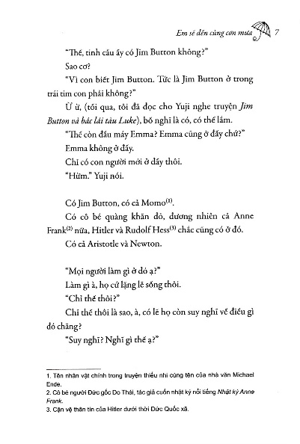
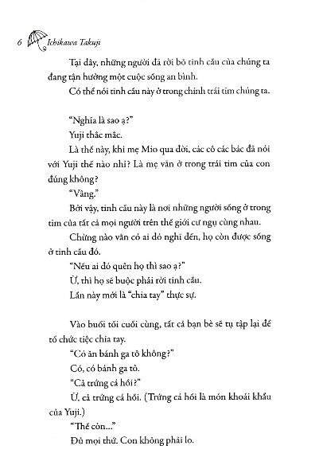
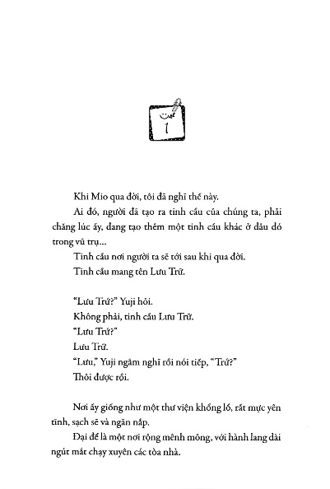
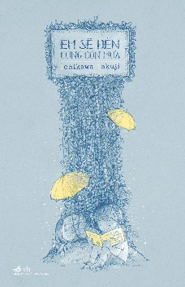
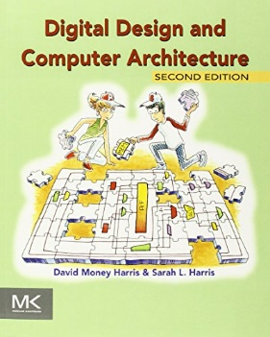
Line (Book)
Set
Block (Pages)

Slide 11



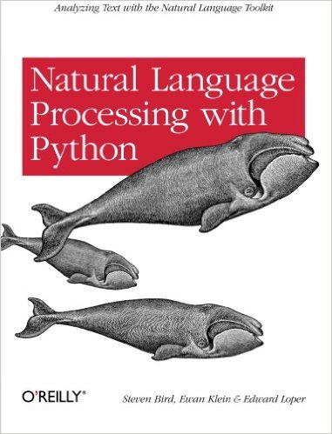










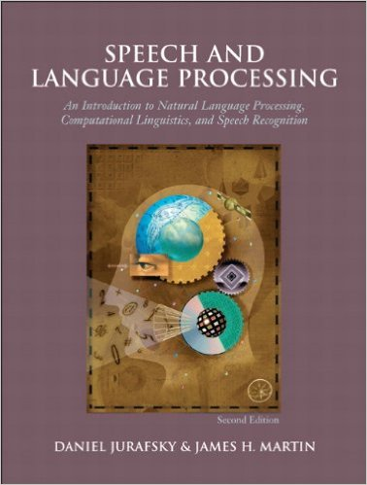
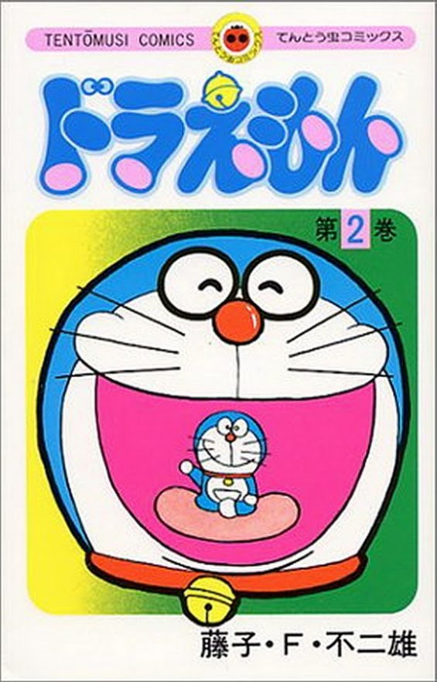



Cache Concepts
Memory
CPU
Cache

Slide 12


Put any book anywhere
$→$ hard to find
Notes:
Hard to find

Slide 13

A
B
C
D
E
F
Y
Z
…
$→$ easy to find
conflict
Notes:
conflict

Slide 14
…
A or B or C
D or E or F
Y or Z
Notes:
…

Slide 15
Fully-Associative Cache
Address of char
Valid?
Match?
t bits
101
v
tag
0
1
2
3
4
5
6
7
v
tag
0
1
2
3
4
5
6
7
Block offset
v
tag
0
1
2
3
4
5
6
7
v
tag
0
1
2
3
4
5
6
7
1 set
char (1 bytes) is here
...
v
tag
0
1
2
3
4
5
6
7
v
tag
0
1
2
3
4
5
6
7
Notes:
1 set

Slide 16
Direct-Mapped Cache
Valid?
Match?
Address of int
t bits
0…01
100
Block offset
v
tag
0
1
2
3
4
5
6
7
v
tag
0
1
2
3
4
5
6
7
S = 2^{s} sets
Find set
...
int (4 bytes) is here
v
tag
0
1
2
3
4
5
6
7

Slide 17
2-Way Set-Associative Cache
Address of short int
Valid?
Match?
t bits
0…01
100
v
tag
0
1
2
3
4
5
6
7
v
tag
0
1
2
3
4
5
6
7
Find set
Block offset
v
tag
0
1
2
3
4
5
6
7
v
tag
0
1
2
3
4
5
6
7
...
short (2 bytes) is here
v
tag
0
1
2
3
4
5
6
7
v
tag
0
1
2
3
4
5
6
7

Slide 18

Valid bit
Write through
multiple copies
Write back
v
tag
0
1
2
3
4
5
6
7
Notes:
1 set

Slide 19
Summary
Cache Concepts
Cache Hit
Cache Miss
Cache Organization
Direct-mapped
E-way Set Associative
Fully Associative

Slide 20
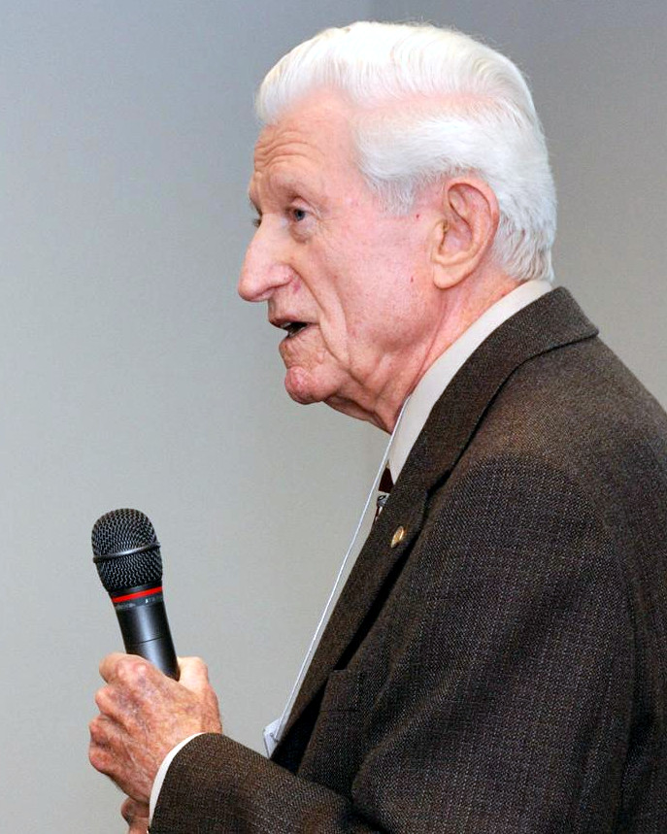


Gene Myron Amdahl
formulating Amdahl's law
$$S_{latency}\left(s\right)=\frac{1}{\left(1−p\right)+\frac{p}{s}}$$

